Slide 1
Mediastinal Syndrome
By
Dr. Essam Elbadry

Slide 2
Mediastinum
the mass of tissues and organs separating the two pleural sacs, between the sternum in front and the vertebral column behind, containing the heart and its large vessels, trachea, esophagus, thymus, lymph nodes, and other structures and tissues; it is divided into superior and inferior regions, the latter subdivided into anterior, middle, and posterior parts

Slide 3
Anterior mediastinal mass
The differential diagnosis for the anterior mediastinal mass is traditionally known as the "four T's":
Thymoma
Teratoma
Thyroid goitre or tumour
Terrible lymph nodes (eg lymphoma)

Slide 4
Anterior mediastinal mass
Lymphoma

Slide 5
Anterior mediastinal mass
Lymphoma

Slide 6
Large nodular goiter, plunged in the mediastinum

Slide 7
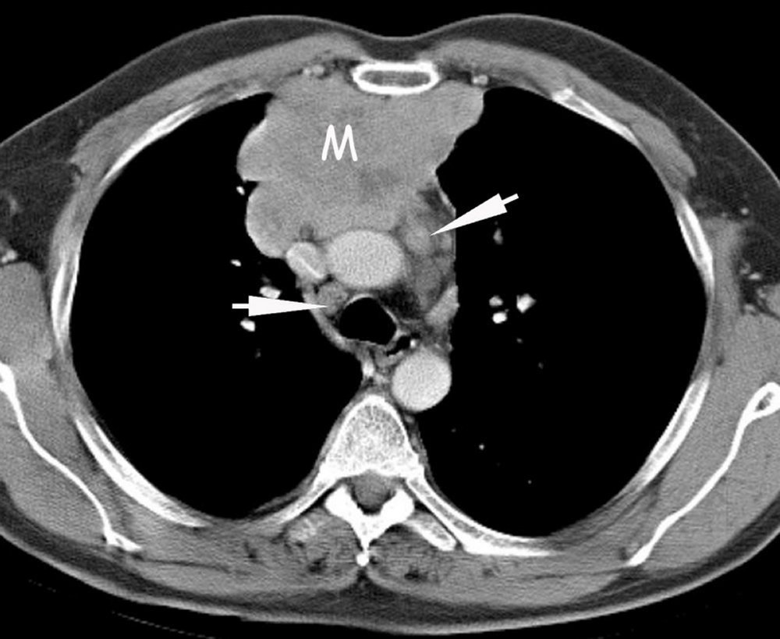
Mediastinal mass
A contrast-enhanced CT shows an anterior mediastinal mass (M) containing hypodense areas caused by necrosis. Note the right paratracheal and aorticopulmonary lymph nodes (arrows).

Slide 8
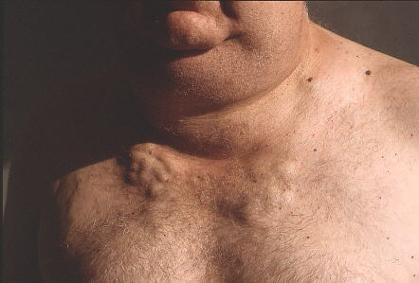
Large nodular goiter, plunged in the mediastinum.

Slide 9
FIBROSING MEDASTINITIS
this disease have developed an intense fibrotic process that leads to compression of the mediastinal structures that can lead to the superior vena cava syndrome, or obstruction of the pulmonary arteries or veins as shown in the above picture. ONE OF THE ETIOLOGIES IS Histoplasmosis.

Slide 10
SVC syndrome
Superior vena caval obstruction otherwise known as SVC syndrome which is secondary to obstruction of the SVC with development of collateral pathways. The etiology is either a malignant or benign lesion. Malignant lesions account for (80% to 90%) of such occurrences with bronchogenic carcinoma accounting for greater than (50%) followed by lymphoma. Benign causes include granulomatous mediastinitis (usually histoplasmosis, sarcoidosis, TB). Other benign etiologies include substernal goiter, ascending aortic aneurysm, and constrictive pericarditis.
Collateral routes include esophageal venous plexus which are also known as (downhill varices). In addition, azygos and hemiazygos veins. Also accessory hemiazygos and superior intercostal veins. Lateral thoracic veins and umbilical veins can also be visualized. In addition, vertebral veins. Patients may present with head and neck edema, cutaneous enlarged venous collaterals, headache, dizziness, syncope. With benign etiology there is a slower onset and progression. With malignancy, there is rapid progression within weeks. Radiographic manifestations include superior mediastinal widening. In addition, encasement, compression, and occlusion of the superior vena cava. One may see dilated cervical and superficial thoracic veins. In addition, thrombus within the superior vena cava as in this case may also be present.

Slide 11
SVC syndrome

Slide 12
SVC syndrome

Slide 13
Thymoma and Myasthenia gravis

Slide 14
Thymoma and Myasthenia gravis
Thymomas are the most common primary thymic tumor. They are slow-growing lesions and usually behave in a benign fashion. A subgroup of these tumors have an aggressive nature and are called invasive thymomas. Invasive thymomas typically invade locally and spread along pleural and pericardial surfaces, but they can exhibit extrathoracic metastasis. A thymoma can appear at any age, but most patients are over the age of 40. Radiographically, thymomas are typically round or oval, well-marginated masses that may contain some peripheral calcification.
The association with myasthenia gravis: 50% of patients with thymoma have myasthenia gravis, and 15% of patients with myasthenia gravis have a thymoma. Among patients with myasthenia gravis and a thymoma, 25% show remission of their myasthenic symptoms after thymectomy.

Slide 15
Thank you

